Slide 1


INSTITUTE : UIE
DEPARTMENT : CSE
Bachelor of Engineering (Computer Science & Engineering)
WEB AND MOBILE SECURITY (Professional Elective-I)
(20CST/IT-333)
TOPIC OF PRESENTATION:
Session Hijacking
DISCOVER . LEARN . EMPOWER

Slide 2
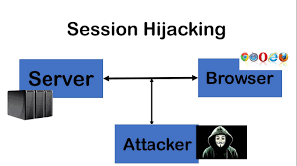
Lecture Objectives
In this lecture, we will discuss:
Introduction to session hijacking , fixation and Prevention.

Slide 3
What is a Session?
A session is a series of interactions that take place within a single connection between two communication endpoints. A web application does not require authentication for every click since, HTTP is stateless, which means designers need to automate tracking the state of multiple connections from the same user.
When a user logs into an application, a session is created on the server to ensure subsequent requests are synchronized.

Slide 4
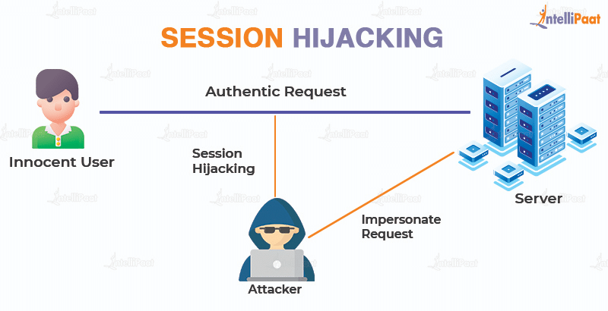
What is Session Hijacking?
An attacker hijacks a user session to gain control over it. A session starts when you log in and out of a service, like your bank’s application. A cookie hijack or cookie side-jacking is an attack that relies on an attacker knowing your session cookie. Session hijacking is commonly associated with web browsers and web applications, yet it can happen with any application.

Slide 5
Difference Between Session Hijacking And Spoofing
Session hijacking and spoofing are closely related, but the timing of their attacks differs. Session hijacking occurs when an attacker hijacks a user’s login and authentication credentials. And from the victim’s point of view, it often results in unpredictability or crashes of the targeted application.
When spoofing occurs, attackers use stolen or counterfeit tokens to initiate a new session that appears to be set by the original user.

Slide 6
Different Methods/techniques Of Session Hijacking.
Cross Site Scripting
Malware Attack
Browser Hijacking
Phising Attack
Session Sniffing
Session Fixation
Session Side Jacking
Predictable Session Token

Slide 7
Cross-site scripting session hijacking (XSS):
When an attacker exploits vulnerabilities within a server or application, he injects Java scripts into a user’s web page, causing the browser to run arbitrary code.
Moreover, injected scripts will be able to access your session key if the server does not set HTTP. Only in session cookies, thus, giving attackers the information required for session hijacking.
Session Side Jacking:
An attacker can intercept the session cookies of a user after he or she authenticates them by using packet sniffing. By using SSL/TLS only for its login pages, the website takes the easy route and the attacker can steal the session key and impersonate the user to operate the web application.
Generally, this happens with an unsecured WiFi Hotspot, as the attacker can access the network, monitor the traffic, and then set up their access points to conduct the attack.

Slide 8
Session Fixing:
Using a session key, attackers gain access to the server by spoofing the user’s credentials.
Due to stateless protocols, there is a threat of session hijacking. It is these limitations that make the protocols vulnerable to attacks.
An SSL connection uses Secure Sockets Layers, which protect any personal information required to pass between the two systems. Thus, it reduces the risk of criminals reading and modifying the messages sent over the internet.
Transport Layer Security (TLS) is simply an updated, more secure version of SSL.

Slide 9
Precautions against Session Hijacking.
Used encrypted protocols such as SSL/TLS to share files and folder or login details.
Using long random generated number for session key is very important.
For every session regenerate separate keys.
After using service user must be logout so that session must be closed properly.
Always used incongito window so that it can't store any cookie in browser.

Slide 10
How to Prevent Session Hijacking
3. Use a VPN. A VPN helps prevent attackers from intercepting traffic, making it more difficult for them to steal session IDs (McCann & Hardy, 2022).
4. Keep software up to date. Make sure to keep operating systems and software up to date with the latest security patches to prevent attackers from exploiting vulnerabilities to access users’ sessions.
5. Take cybersecurity training. Cybersecurity threats are constantly evolving, so it’s essential to stay informed on the latest attack techniques and how to prevent them. Consider getting certified in various cybersecurity domains, including ethical hacking, incident handling, and penetration testing.
1. Use strong passwords and multifactor authentication. These techniques protect accounts from being accessed by hackers if they manage to steal a user’s session.
2. Only share session IDs with trusted sources. Be careful when sharing links or sending requests to websites, as these may include session IDs.

Slide 11
Session fixation vs session hijacking
In the session hijacking attack, the attacker attempts to steal the ID of a victim's session after the user logs in. In the session fixation attack, the attacker already has access to a valid session and tries to force the victim to use that particular session for his or her own purposes.
Session fixation is a web attack technique. The attacker tricks the user into using a specific session ID. After the user logs in to the web application using the provided session ID, the attacker uses this valid session ID to gain access to the user’s account.

Slide 12
References:
Books:
Web Design With HTML, CSS, JavaScript and jQuery Set, 1st Edition, by Jon Duckett.
Hacking Exposed Web Applications, 3rd edition, Joel Scambray, Vincent Liu, Caleb Sima, Released October 2010, Publisher(s): McGraw-Hill
Video Lectures :
https://www.youtube.com/watch?v=GNmU5vwZua8
https://intellipaat.com/blog/what-is-session-hijacking/
Reference Links:
https://www.cpltutorials.com/What-is-Session-Hijacking-and-Different-methods-of-Session-Hijacking/
https://owasp.org/www-community/attacks/Session_fixation
https://resources.infosecinstitute.com/topic/session-hijacking-cheat-sheet/
https://www.geeksforgeeks.org/advanced-session-hijacking-and-how-to-protect-yourself/

Slide 13

THANK YOU

